Slide 1
Final Project
SNS CCL Orbit Correction
Michelle Miller
Alyssa Miller
Trudy Bolin
Salvador Sosa
USPAS
Control Room Accelerator Physics
Albuquerque, New Mexico
June 17 - 28, 2019

Slide 2
CCL (coupled-cell linac) Orbit Correction
Orbit correction is a classical task for almost every accelerator.
Statement of Problem
Create a script that will correct the vertical orbit in the CCL section of the SNS accelerator
The script will communicate through EPICS with the OpenXAL Virtual Accelerator for the DTL6-CCL1-CCL2-CCL3-CCL4 subsequence. The orbit distortion will be created by one of the dipole correctors in DTL6
Correct the orbit without using the OpenXAL online model
By using the virtual accelerator, measure the response of all CCL BPMs to all vertical dipole correctors (DCV) and create a response matrix
Solve the optimization problem by minimizing the vertical orbit deviation at the BPMs’ position by applying limited kicks from correctors
Note: In CCL the DCV magnetic field is limited to 0.012 T

Slide 3
Algorithm
Kicks
Response Matrix
Make a script start a virtual accelerator
Create a 2D array for kicks and BPM positions
Introduce kick to upstream dipole corrector (store in array)
Record all BPM’s (store in array)
Introduce another kick to downstream dipole corrector (store)
Again record all BPM’s
Go to next step
Introduce kick at a given dipole corrector
Look at all BPM’s and and fix
Go to next dipole corrector and introduce kick
Look at all BPM’s and fix
And so on
Create a response matrix
Correction
Go to next step
Invert response matrix
Results are used to provide the correction kicks
given the BPM readbacks
This will be used to correct any random error
Scan of the BPMs from the Virtual Accelerator
Optimization done offline

Slide 4
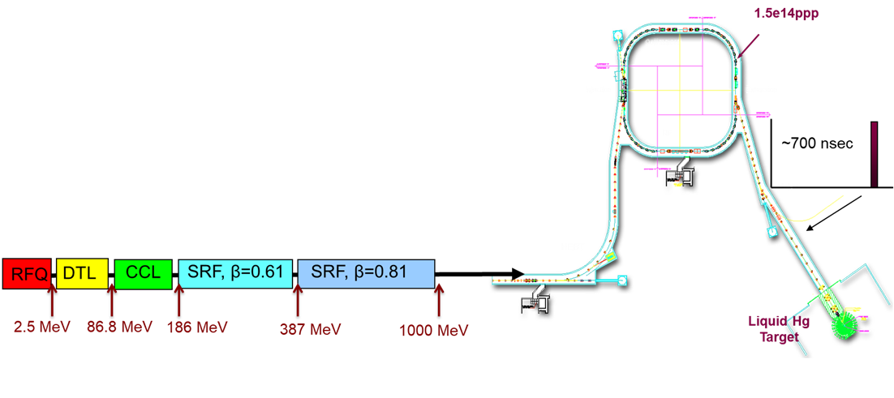
SNS Linac
Orbit distortion in DTL6
Orbit distortion in DTL6
Orbit correction in DTL6
Ion Source
RFQ
2.5 MeV
87 MeV
186 MeV
387 MeV
1000 MeV
MEBT
DTL
CCL
SRF, β=0.61
SRF, β=0.81
To RING
RF
cavities
4 cav.
6 cav.
4 cav.
33 cav.
48 cav.
Warm (normal temperature)
linac
Cold (superconducting)
Linac (SCL)

Slide 5
Response Matrix
DCV
BPM
Initial BPM readings.
10 BPM’s
18 Dipole Correctors
Algorithm
Minimize orbit distortion by changing correctors

Slide 7
Results

Slide 8
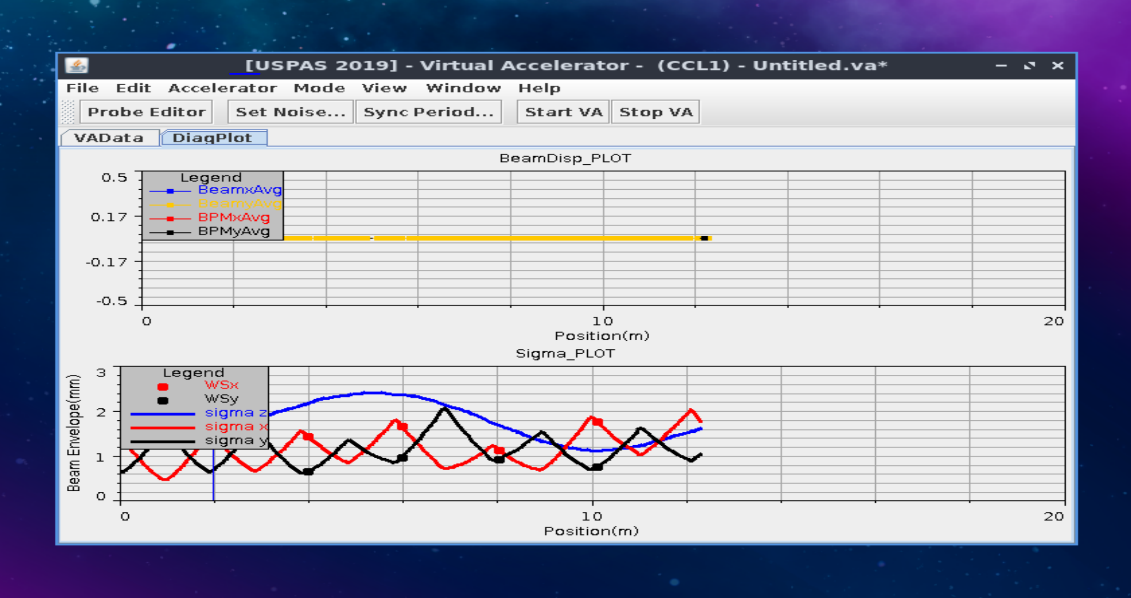
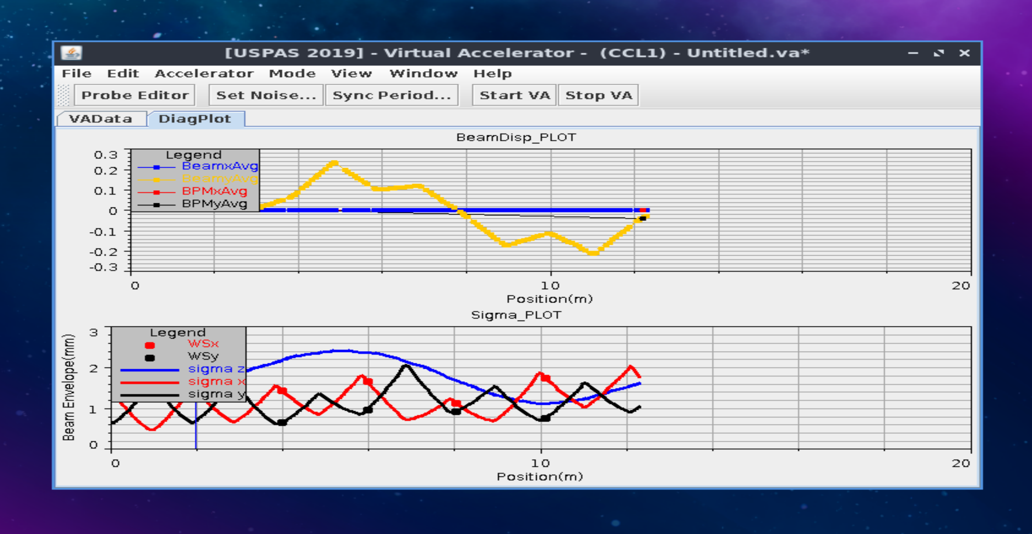
Ideal and Perturbed Orbits

